Slide 1


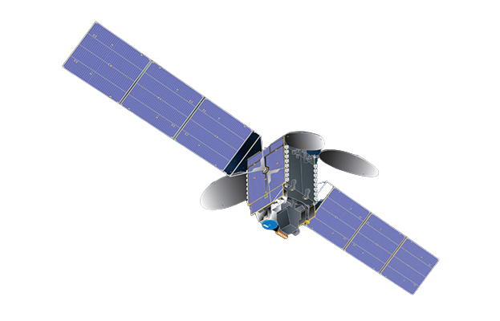



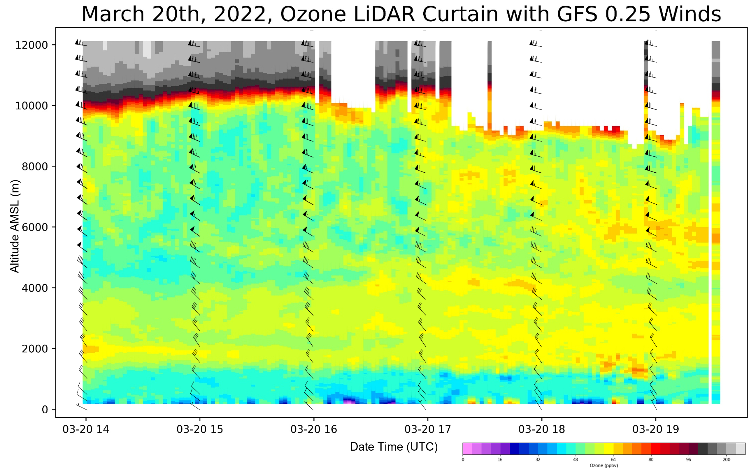
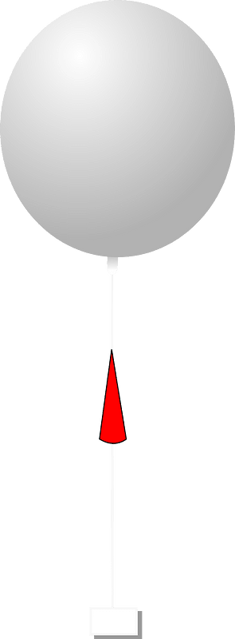

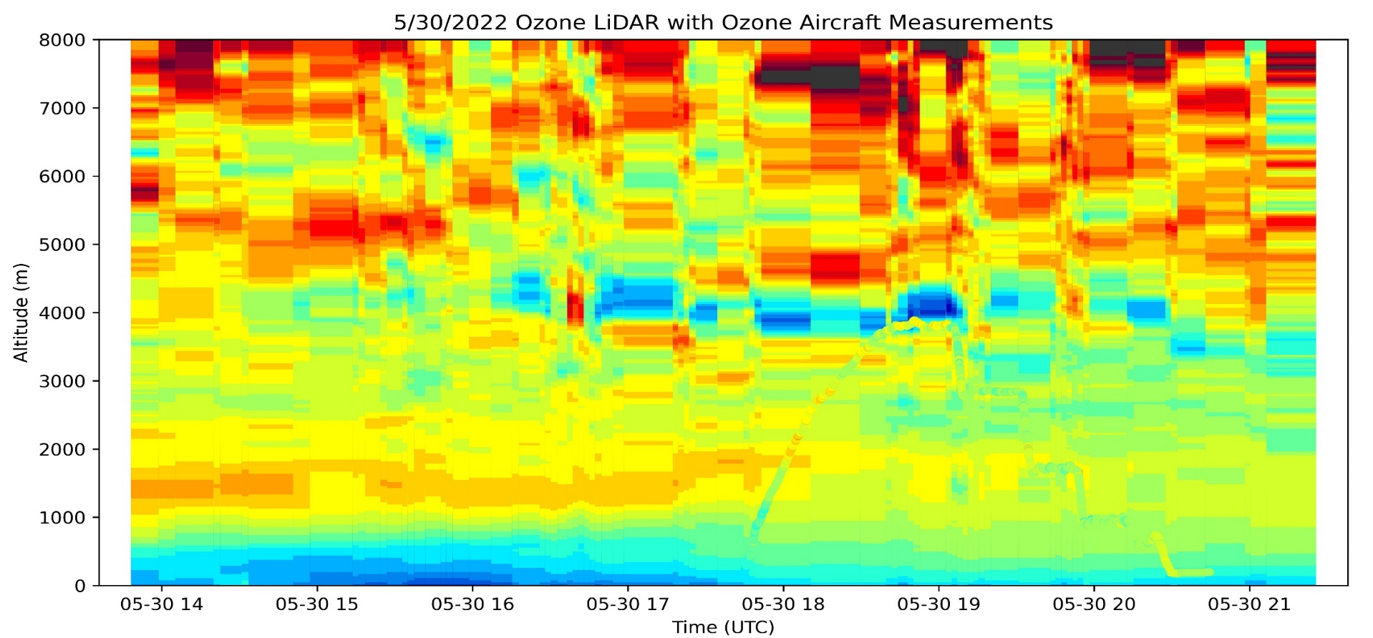
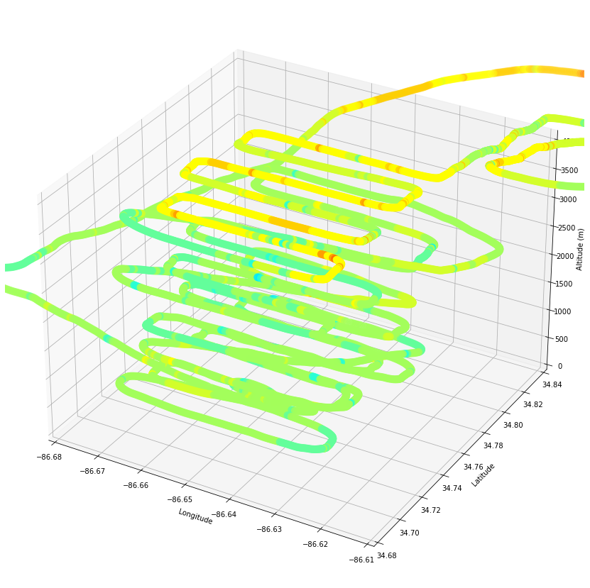
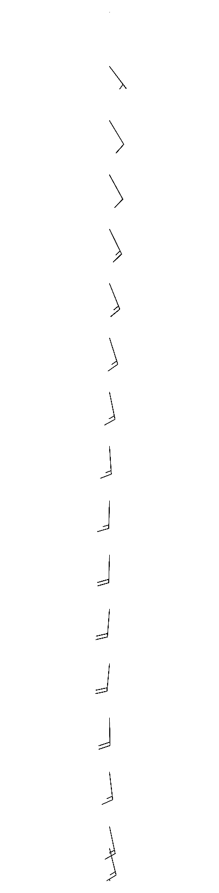

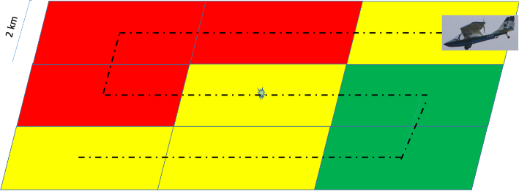
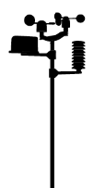
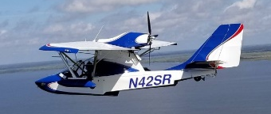


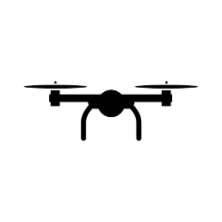


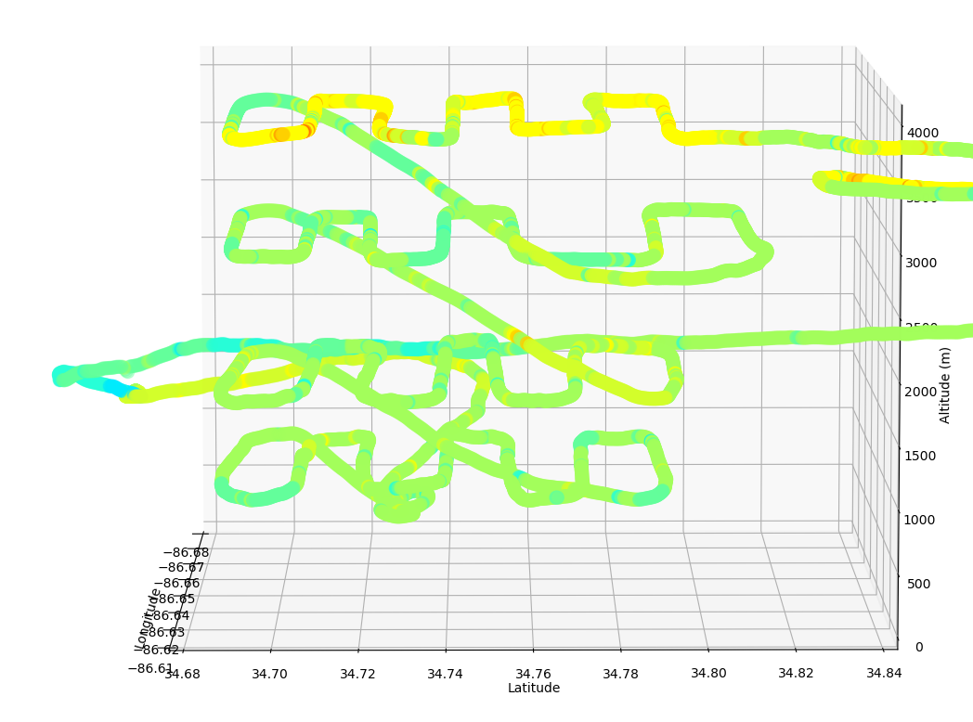

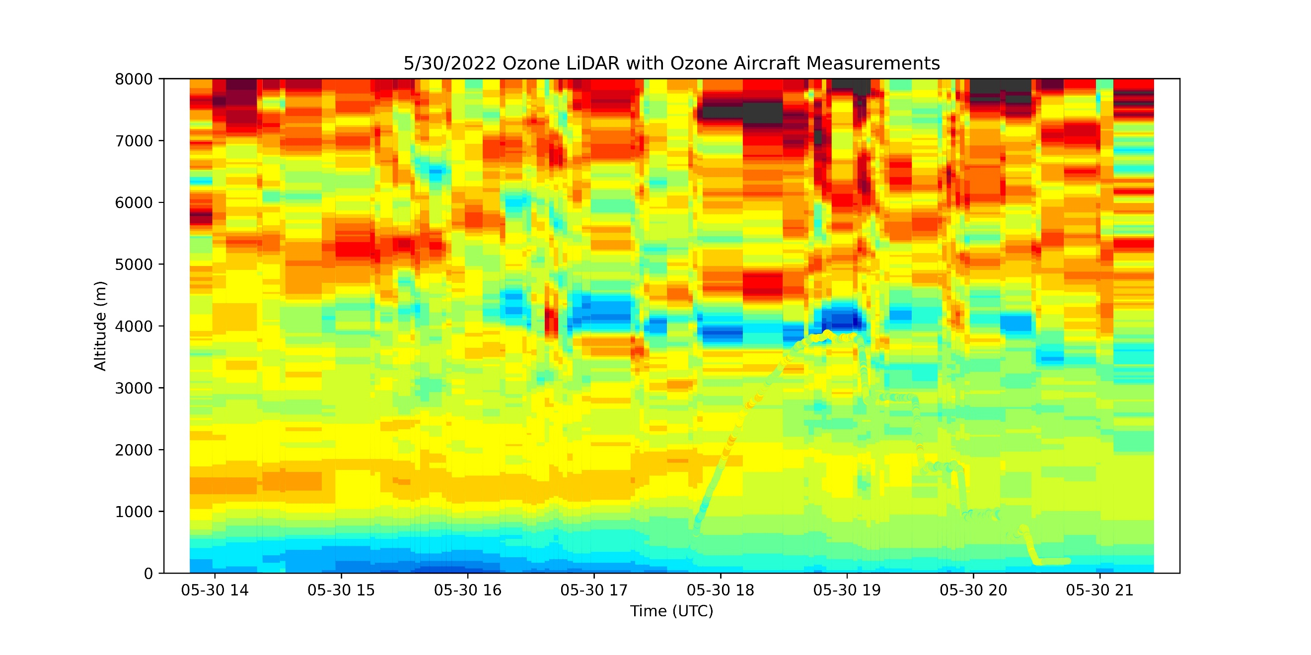
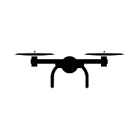
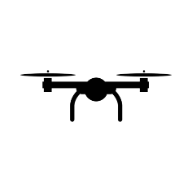



TEMPO PBL Ozone Accuracy and Precision Assessment with Aircraft, LiDAR, Balloon, and Drone Measurements
Joint Science Meeting for TEMPO, GeoXO ACX, & TOLNet in Huntsville, AL USA May 1, 2023
Airborne observations conducted in coordination with the RO3QET Ozone LiDAR will quantify ozone and aerosol concentrations in the planetary boundary layer (PBL 0-2km). By strategically positioning flight patterns that coincide with TEMPO pixel sizes and location, the LiDAR, aircraft, drones, and balloons can obtain time-altitude-horizontal measurements that offer precise insight into the PBL ozone levels and spatio-temporal structure that will be measured by TEMPO. These measurements will facilitate assessing the ability of TEMPO to incorporate laminar structure and temporal gradients into their retrievals and deriving implications for surface concentrations. Several mini-campaigns demonstrate this approach.
$${\text{Mike} \text{Newchurch}}^{1}, {{\text{Shi} \text{Kuang}}^{1},\text{Todd} \text{McKinney}}^{1}, {\text{Susan} \text{Alexander}}^{1}, {\text{Paula} \text{Tucker}}^{1},$$
${\text{Darby} \text{Stevenson}}^{1}$, ${\text{Mason} \text{Mills}}^{1}$, ${\text{Nick} \text{Perlaky}}^{1}$, ${\text{Xiong} \text{Liu}}^{2}$, ${\text{Kelly} \text{Chance}}^{2}$
$${}_{ }^{1}{\text{University} \text{of} \text{Alabama} \text{in} \text{Huntsville}}, {}_{ }^{2}{\text{Harvard} \text{Smithsonian} \text{Astrophysical} \text{Observeratory}}$$
Example TEMPO Validation Plan

